Slide 1

SPRINGBOARD GUIDED CAPSTONE
A. OZGUN UZER

Slide 2
INDEX
1. PROBLEM IDENTIFICATION
2. RECOMMENDATION & KEY FINDINGS
3. MODELING RESULTS & ANALYSIS
4. CONCLUSION

Slide 3
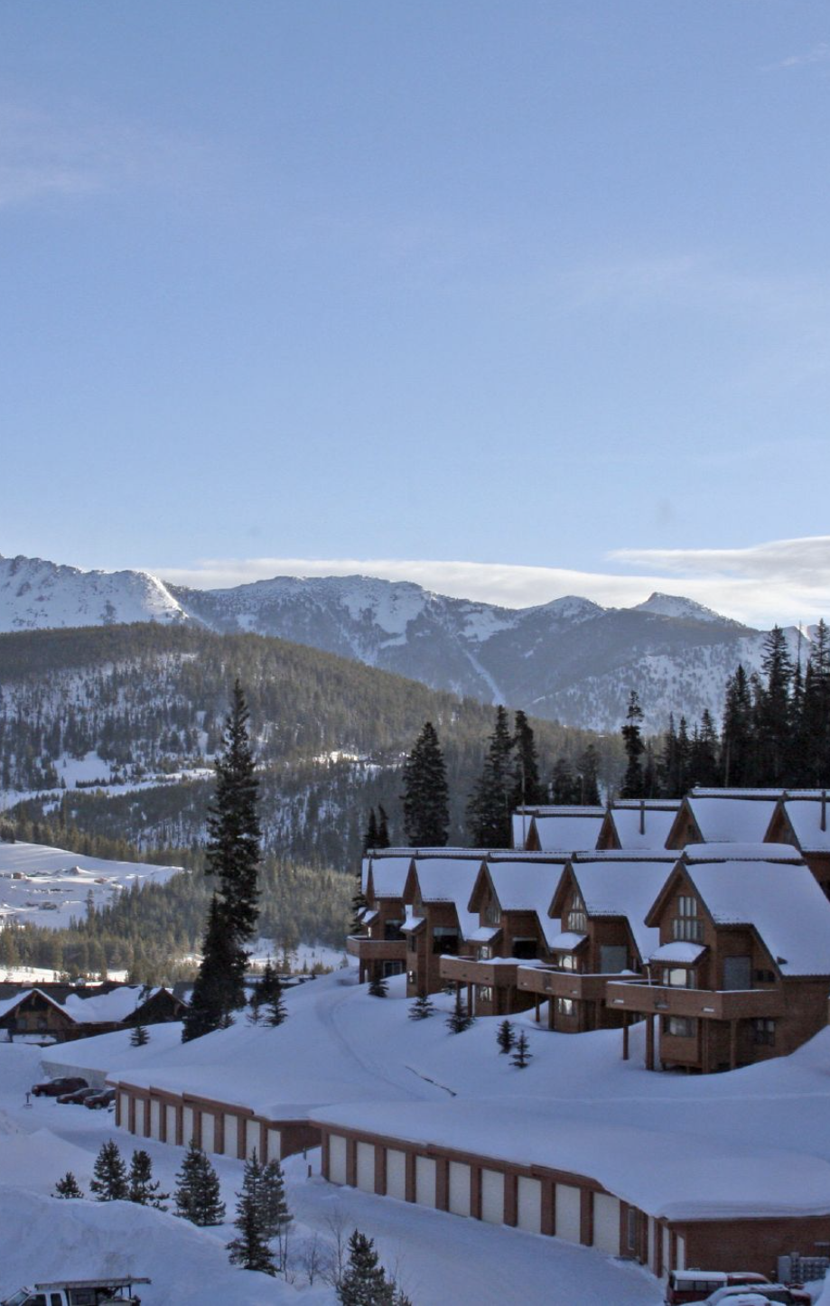
1.PROBLEM IDENTIFICATION
The Resort has recently installed an additional chair lift. This adds $1,540,000 to our cost.
The pricing strategy has been to charge a premium above the market average.
Our goal is to understand;
If we are capitalizing on our facilities as much as we could
How other scenarios might change/ effect the price

Slide 4
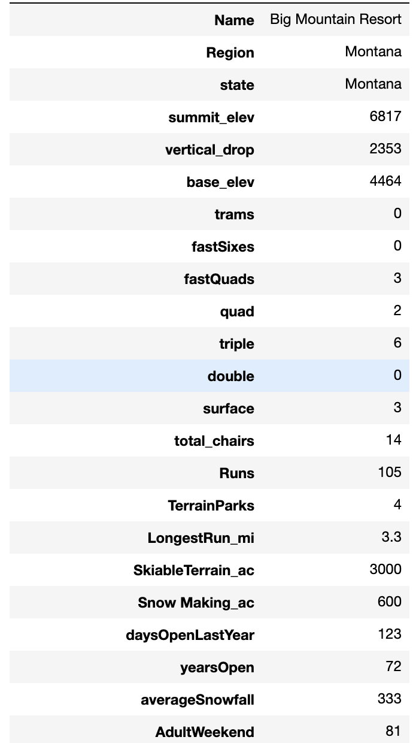
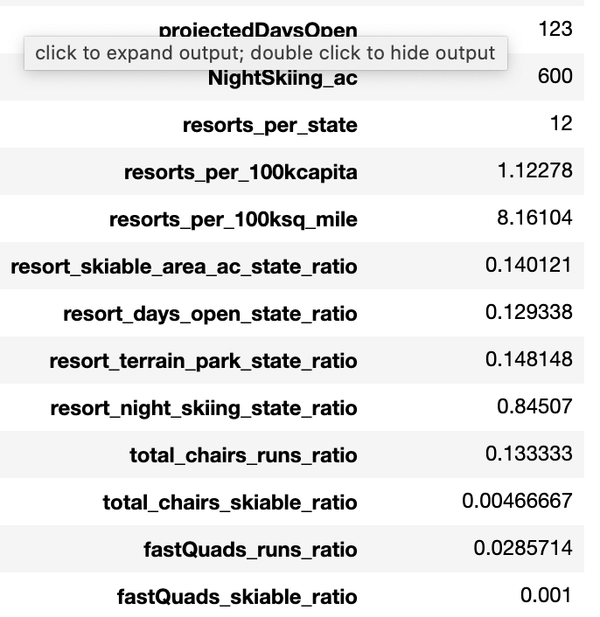
1. PROBLEM IDENTIFICATION
To solve this problem;
We tried to understand the relationship between the given attributes and how they effect the hotel price
We used a dataset that has attributes and prices for each ski resort in US and took some data from Wikipedia to understand how each state population, area etc. effects the price.

Slide 5
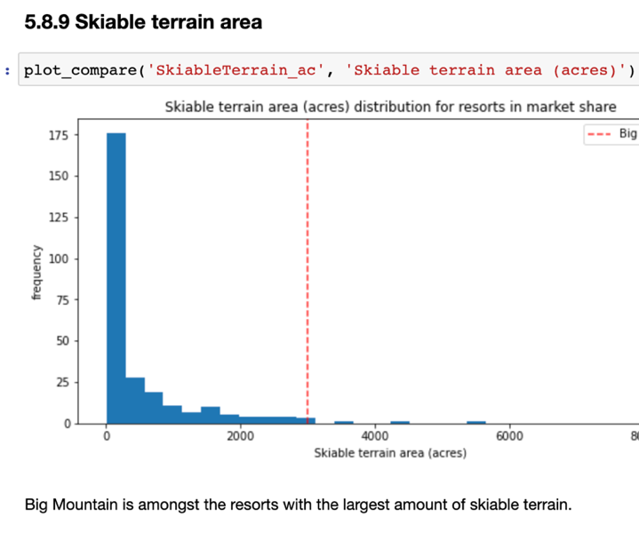
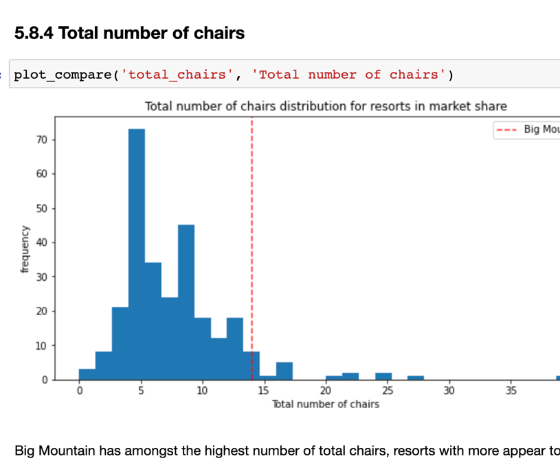
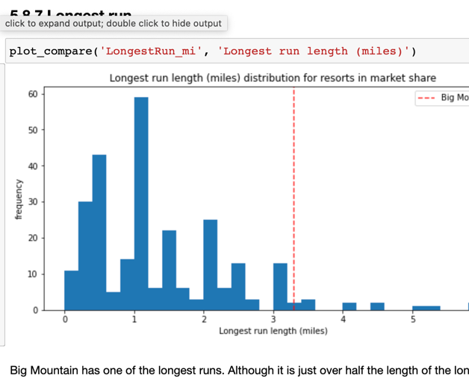
2. RECOMMENDATION & FINDINGS
For the attributes that effects the price -as well as the price - Big Mountain is in the higher percentile

Slide 6
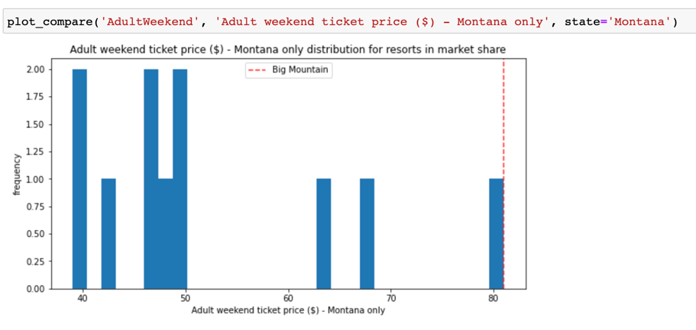
3. MODELING RESULTS & ANALYSIS
How good the mean is for predicting the ticket price?
MAE ~ 19
MSE ~ 614
Random Forest:
MAE ~ 9.5 with 1.6 std
Important attributes:
• vertical_drop.
• Snow Making_ac
• total_chairs
• fastQuads
• Runs
• Longest Run_mi
Trams
SkiableTerrain_ac

Slide 7
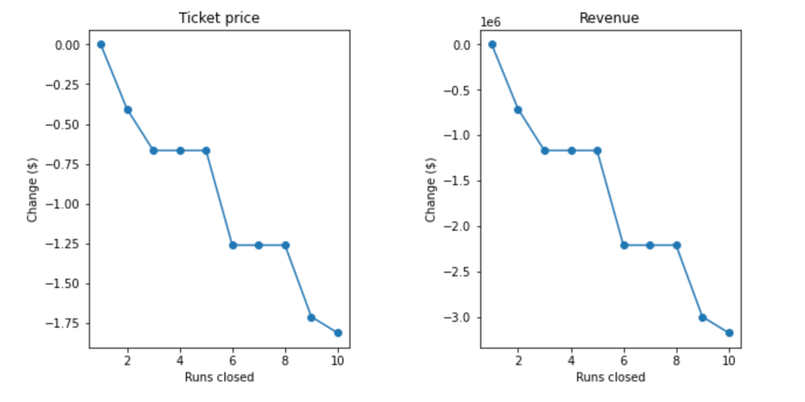
3. MODELING RESULTS & ANALYSIS
Below are some scenarios we tried to understand:
Close up to 10 of the least used runs
Here we find that closing one run makes no difference where closing 2 and 3 reduces support for ticket price. If the resort closes 3 runs it can close 4 and 5 which will not create any revenue impact.

Slide 8
3. MODELING RESULTS & ANALYSIS
2. In this scenario, we are adding a run, increasing the vertical drop by 150 feet and installing an additional chair lift.
This scenario increases support for ticket price by $8.61
Over the season $15,065,471
3. This scenario repeats previous but adds 2 acres of snow making ac.
Support for ticket price by $9.90.
Over the season $17,322,717
4. This scenario calls for increasing the longest run by 0.2 miles and adds 4 acres of snow making capability.
No difference for this scenario

Slide 9

4. CONCLUSION
We calculate the price for Big mountain resort by using the random forest model and we see that the predicted price is $95 (actual is $81) which means that there is room for increase.

